Slide 1

Turkey’s eCommerce
Cihad Palta
Artur Moeijes

Slide 2
Table of contents
eCommerce in Turkey in 2016
The top 10 biggest eCommerce webshops
Growth of eCommerce in Turkey 2013-2016

Slide 3
eCommerce in Turkey in 2016
Share in Turkey’s retail:
1,7% in 2012 -> 3.5% in 2016
Other ecommerce industries around the globe ~ 8,5%
6.4 billion euros begin 2015
to 6.95 billion euros end 2016
Worth of 7.95 billion euros in 2017
Notes:
https://ecommercenews.eu/ecommerce-turkey-worth-7-95-billion-euros-2016/

Slide 4
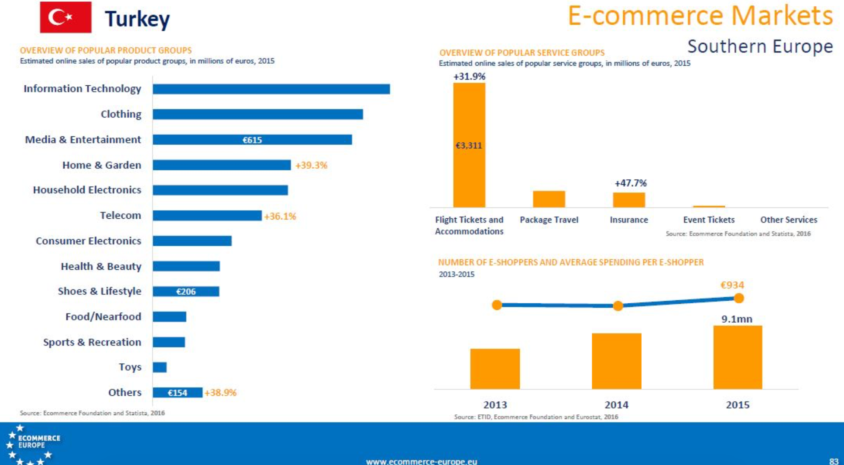

Slide 5
The biggest eCommerce webshops
Top 10
Gitti Gidiyor, Hepsiburada and Trendyol
are dominating in online marketplaces,
multi-category retailers and private shopping sites
GittiGidiyor
Hepsiburada
Trendyol
Sahibinden
Markafoni
Vipdükkan
Limango
Yemeksepeti
n11.com
Biletix
Notes:
GittiGidiyor (eBay Turkey) is doing a great job in keeping the leadership. Hepsiburada has a strong Year-over-Year (YoY) growth and comes close to the neck of GittiGidiyor as never before. Number three is Markafoni. The biggest growth rates in in the last years come from Private Shopping Players, especially Vipdükkan, Limango and Markafoni. One of the major lovebrands of the Turkish eCommerce, Yemeksepeti, continued to stay among the top 20 with a tremendous growth rate of 51% (which is the 7th highest growth rate, and faster than the top 2 players). Same with Biletix which managed to reach 55% growth rate.
The big winner in the Turkish eCommerce is Private Shopping as a segment. Turkey is one of those countries accepting and loving this flash sales offering. The competition is tough. The Private Shopping sites discovered TV ads and started to reach out for new customer segments. And we might face some surprises as Vipdükkan is growing like hell (but from low levels) and has the chance to become the number three in this segment and pushing Trendyol down to number four. Hepsiburada is the big old lady of the Turkish eTailers. If we would do a ranking according the revenues, they would clearly lead the eCommerce. Yes, they are big but are growing in an impressive way: 43% is very respectable for a big player. Vatan is leading the Consumer Electronics Segment. Teknosa and Hizlial are following. And we have six newcomers among the top 20: Five Private Shopping Players and the shoes vertical zizigo. Vipdükkan made the highest new entry.

Slide 6
Gitti Gidiyor
The name Gitti Gidiyor means “Going, Going and gone”
Gitti Gidiyor was founded in 2011
Most widely-used e-shopping mall in Turkey
7 million registered users
500 thousend daily visitors
4 million listing at any given time
http://yardim.gittigidiyor.com/yeni-uyeler/about-gittigidiyor
Notes:
Being a subsidiary of the world's largest online marketplace eBay Inc., GittiGidiyor is the most widely-used e-shopping mall in Turkey with more than 7 million registered users, over 500 thousand daily visitors and 4 million listings at any given time. With more than 150 employees, GittiGidiyor.com is one of the leading players in the Turkish online trading market.
GittiGidiyor.com was founded in 2001 by Serkan Borançılı, Burak Divanlıoğlu and Tolga Kabataş and is headquartered in İstanbul.
Following eBay's acquisition of the minority stake in 2007, eBay still owns approximately 93% of the outstanding shares of GittiGidiyor on May 2011. By this new investment GittiGidiyor became fully part of eBay. With more than 17 million internet users and a strong affinity for online commerce, the investment makes Turkey the 37th market where eBay has a local presence.
In GittiGidiyor there is a wide range of products from PC to video games, mobile phones to clothing, jewelry to camera. Collection materials like money, stamp, prayer beads, books etc. are also sold in GittiGidiyor.com
Over 350 thousand sellers can reach many customers from all around Turkey with GittiGidiyor's high technology infrastructure, services designed for different seller profiles and intensive advertising activities.
*The name of the company is the Turkish translation of "Going, going, and gone".

Slide 7
Hepsiburada
7 milion mobile app downloads
65 milion visits per month
Access to over 10 million products
2,4 million mountly shipment
100,000 m2 Fulfillment Center
More than 7.000suppliers
50% of customers are in outside large cities
30 categories
http://www.hepsiburada.com/about-us

Slide 8
Trendyol
Trendyol is by far the biggest fashion e-tailer in Turkey, and the largest retail e-commerce player overall in terms of number of orders.
12+ milion members
The most visited fashion website in Turkey with 400M+ visits annually
2 out of 3 woman in turkey who shop online have shopped on Trendyol
60+ milion fashion items delivered to every city, town and village in Turkey
https://www.trendyol.com/international.html/en#whoWeAre

Slide 9
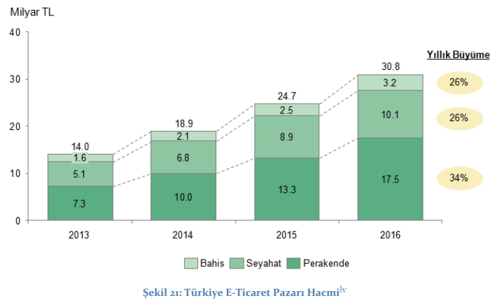
Growth of eCommerce in Turkey 2013-2016

Slide 10
Summary
eCommerce in Turkey in 2016
The biggest eCommerce webshops
Growth of eCommerce in Turkey 2013-2016

Slide 11
Resources
Websites:
https://ecommercenews.eu/ecommerce-per-country/ecommerce-turkey/
https://www.ecommerce-europe.eu/research-figure/turkey/
https://ecommercenews.eu/ecommerce-turkey-worth-7-95-billion-euros-2016/
http://yardim.gittigidiyor.com/yeni-uyeler/about-gittigidiyor
http://www.hepsiburada.com/about-us
https://www.trendyol.com/international.html

Slide 12
Japan E-Commerce
Emre Aydemir 500730246
Redouan el Arbaoui 500739760

Slide 13
Top 8 E-Commerce in Japan
Amazon $9.06 USD Billion
Yahoo $7.80 USD Billion
Rakuten $7.72 USD Billion
Start today $7.2 USD Billion
Zozotown $544 USD Million
DMM $448.8 USD Million
Kakaku $410 USD Million
Apple $135.7 USD Million
Revenue based on 2016 in US Dollars

Slide 14

Rakuten
Speed and innovation
Customer orientated
Rakuten-card (high reward points)
Power in diversity (Hotel reservations, Shopping, financial services, payment system, Baseball team, media, e- reading, mobile messaging)

Slide 15

Yahoo! Japan
Separate company from the U.S. based Yahoo
#1 digital force in Japan
Yahoo! Auctions and Yahoo! Shopping
Power in diversity (Advertising, Auctions, News, Shopping, Credit cards, search engine, Android browser and apps/games)
Collaboration with Criteo

Slide 16
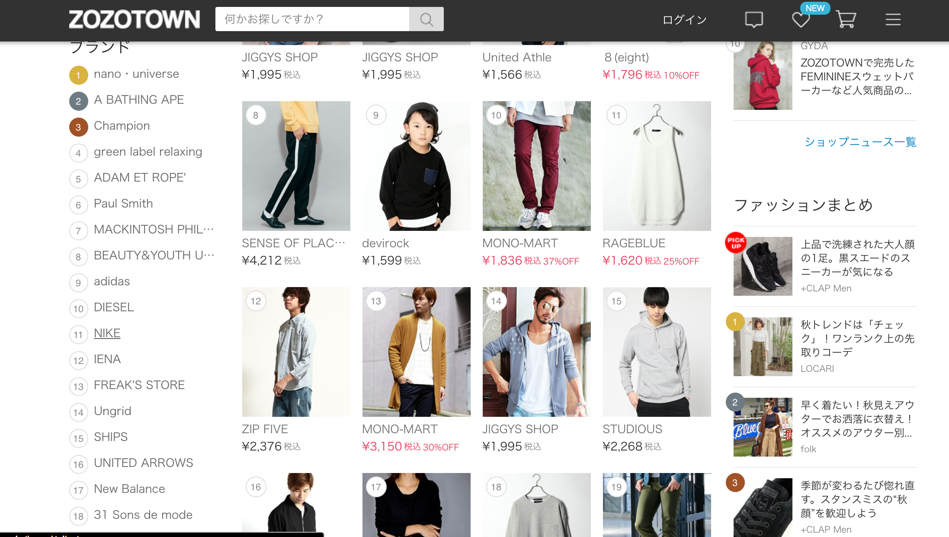
Zozotown
Launched in the year 2004 BY Yusaku Maezawa
The app has been downloaded
more than 8 million times
Zozotown does not invest in inventory,
but instead takes a commission on sales from
its 3,900 brands

Slide 17


Slide 18
Top 10 E-commerce companies USA
Vane Mileski Zohair Arbib

Slide 19



Top 10 highest rated companies
Amazon.
Apple.
Wal-Mart Stores Inc.
Macy’s Inc.
Costco Wholesale.
QVC.
Nordstrom.
Target Corp.
Kohl’s Corp.
Gap Inc.

Slide 20
E-commerce sales
2013
Amazon highest e-commerce sales.
Nordstrom lowest e-commerce sales.
2017
Amazon highest e-commerce sales.
Gap lowest e-commerce sales.
Notes:
QVC voorheen (2013) They were part of the Liberty Interactive Corporation

Slide 21
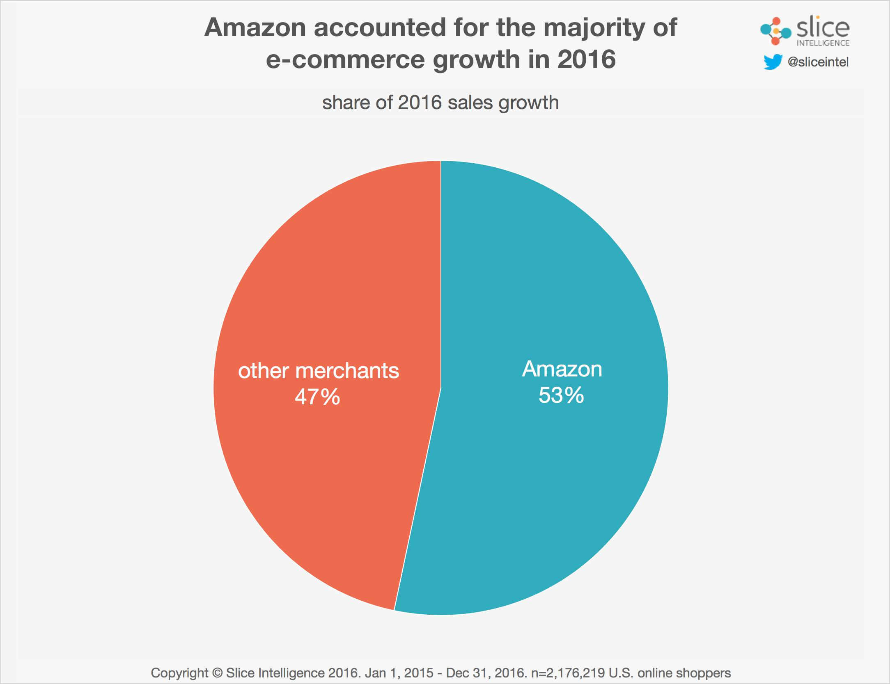
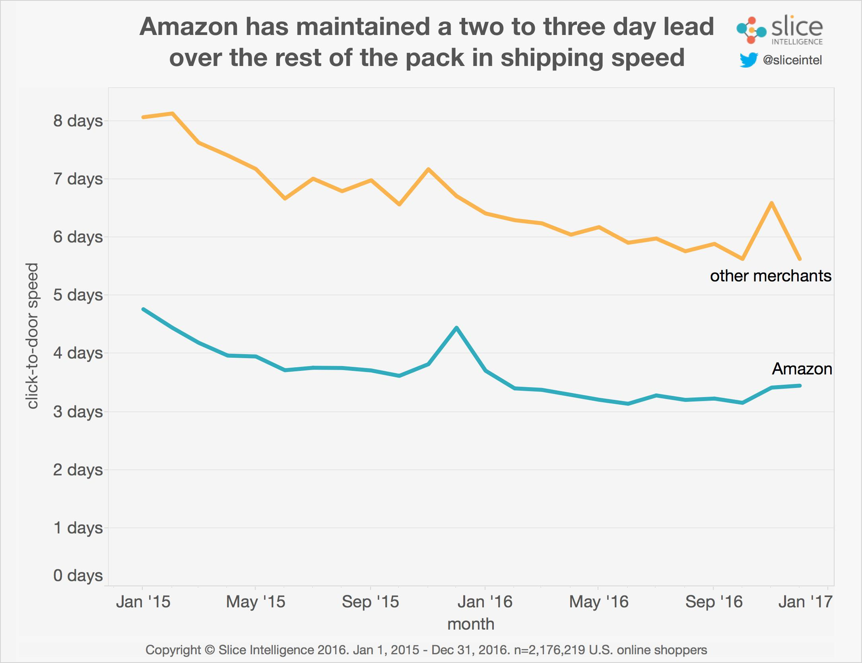

Why Amazon?
They control half of the e-commerce market.
Shipping days of product(s).
Continuesly improving their buying process.
Notes:
Slice attributed much of Amazon's win to its two- to three-day lead when it comes to shipping speed. Whereas the average Amazon package was delivered in 3.4 days, that was 5.6 days from everyone else
Amazon maintains an obsessive focus on removing every pain point from the buying process. This is clearly exemplified with its Prime program, with free, reliably quick shipping," Ken Cassar, principal analyst at Slice Intelligence, said in a blog post. "While the rest of the market is investing to get our packages to us faster, Amazon still maintains a significant lead.“
Shipping days hick-up is because of black Friday and Christmas and other holiday events.

Slide 22
Growth rate
2013
Costco Wholesale highest growth rate.
Macy’s lowest growth rate.
2017
Apple highest growth rate.
Macy’s lowest growth rate.
Notes:
https://nrf.com/2015/top50-e-retailers-table 2013
http://wwd.com/business-news/business-features/amazon-wal-mart-apple-biggest-e-commerce-retailers-10862796/ 2017
https://www.statista.com/topics/846/amazon/ over amazon

Slide 23
Reference list
https://nrf.com/2015/top50-e-retailers-table
http://wwd.com/business-news/business-features/amazon-wal-mart-apple-biggest-e-commerce-retailers-10862796/
https://www.statista.com/topics/846/amazon/
https://www.cnbc.com/2017/02/01/amazon-captured-more-than-half-of-all-online-sales-growth-last-year.html

Slide 24
Top 10 e-commerce companies
United Arabic Emirates (UAE)
Tereza Urbanová, Mattijs van Houten, Romen Klaassen.

Slide 25
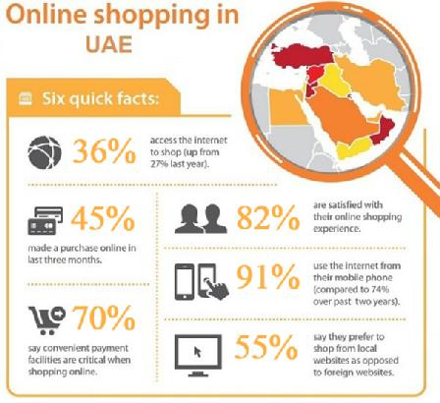
E-commerce in the UAE
valued at $2.5 billion (11-2016)
expected to reach $10 billion by 2018 (export.gov)
60% From other countries
Top countries: US (30%), UK (18%), India (18%)
Perfect product categories: travel and transport (43%), clothing / apparel (40%) (thepaypers.com)

Slide 26
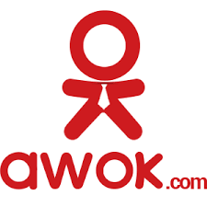
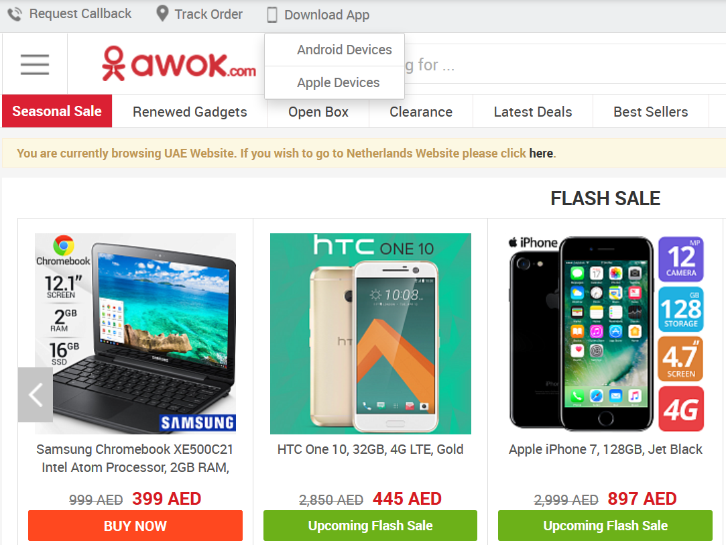
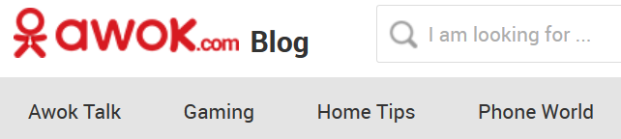
AWOK.com
sells top quality product in electronics, jewelry, toys, …
high quality for low price
annual sales growth 2016: 1100%(!)
become the leading online store in UAE
just 4 years old
Notes:
(very strong year-on-year growth)
Awok blog with recomendation news

Slide 27

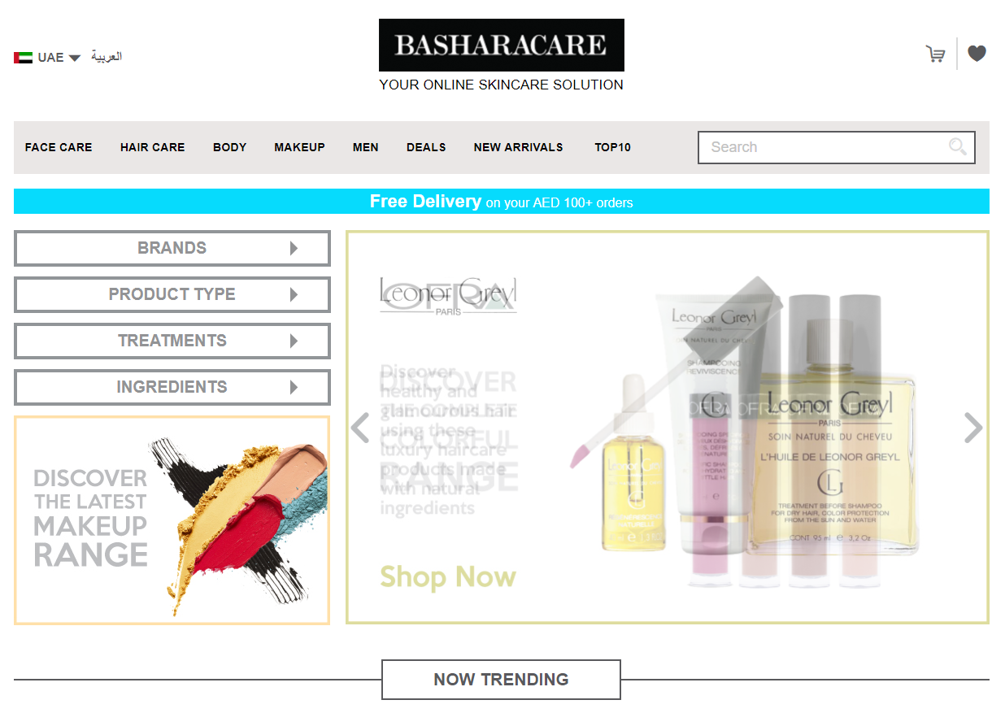
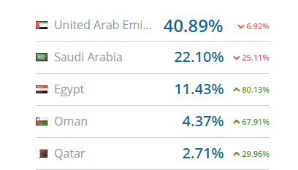
Basharacare
Premium skincare products
Over 90 (international) brands.
Launched in 2013
Expanded in 2015
Backed by professional dermatologists
Traffic by country
Notes:
Around 350k visits last July, 170k in august.
Expanded towards the other GULF countries

Slide 28

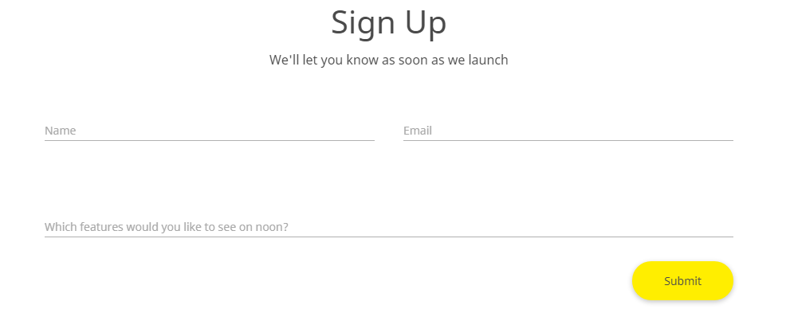
Noon.com
Founded by Emaar chairman Mohamed Alabbar
Launch very soon
20 million products
2 per cent of the total market → 15 per cent (thenational.ae)

Slide 29

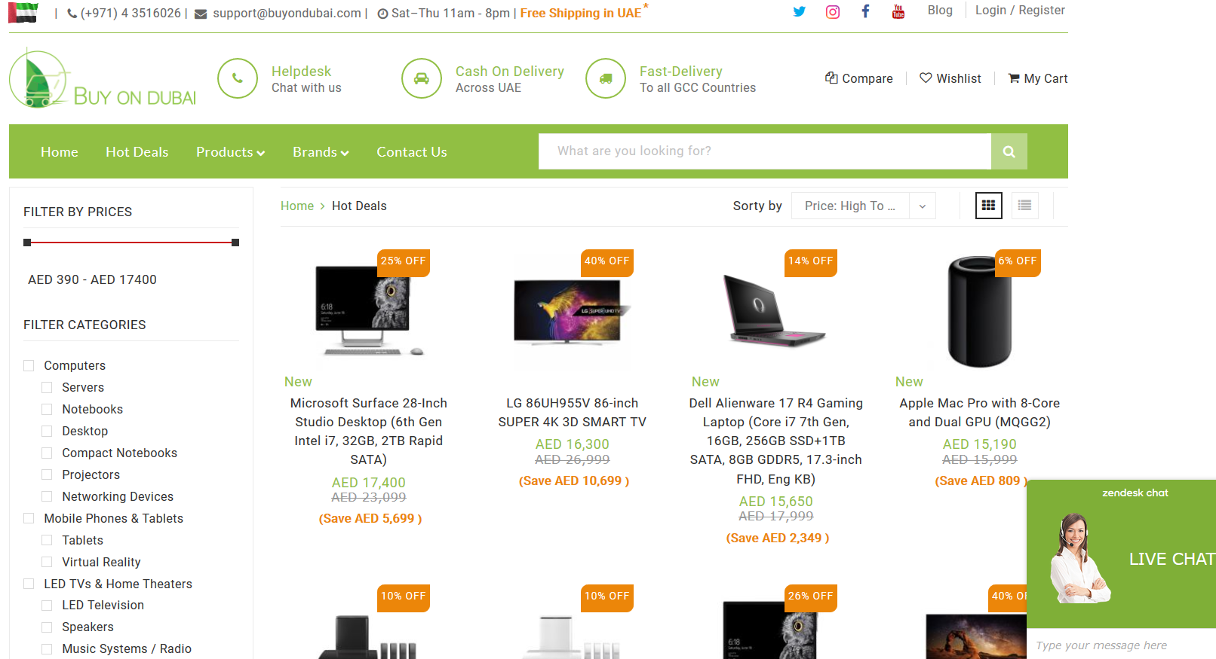
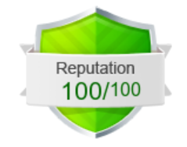
BuyOnDubai.com
receives about 1 250 unique visitors per day
popular among users in the united arab emirates - 22,4% orders from UAE
safa website

Slide 30

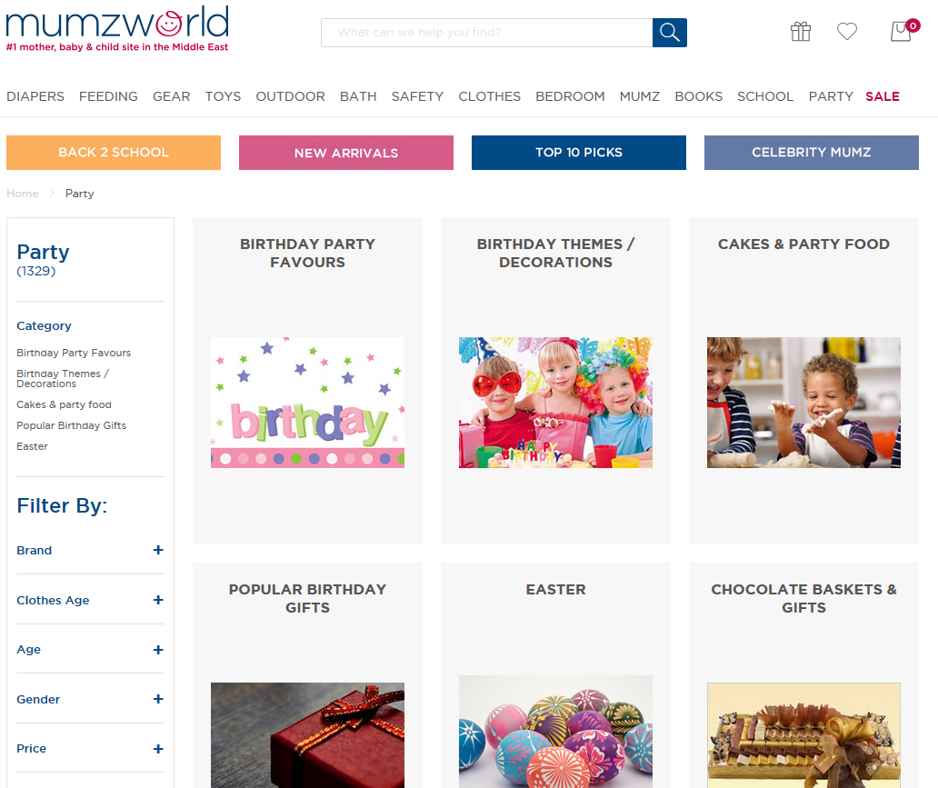
Mumzworld.com
1st and largest online shopping site in the Middle East for mother, baby and child
servicing the UAE -> ship all over the world
offers fashionable, stylish yet highly comfortable products for little kids

Slide 31

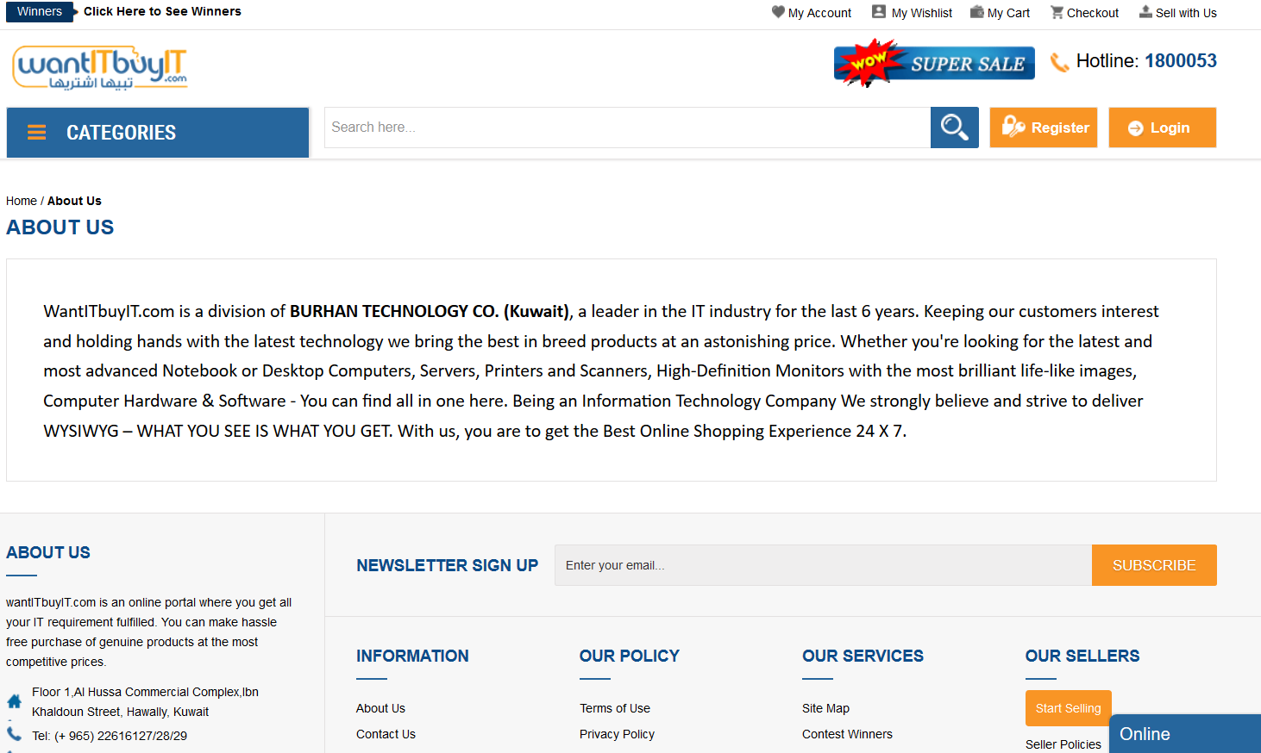
Want IT buy IT
online portal for all IT equipment
a leader in the IT industry for the last 6 years
sells the newest technology

Slide 32

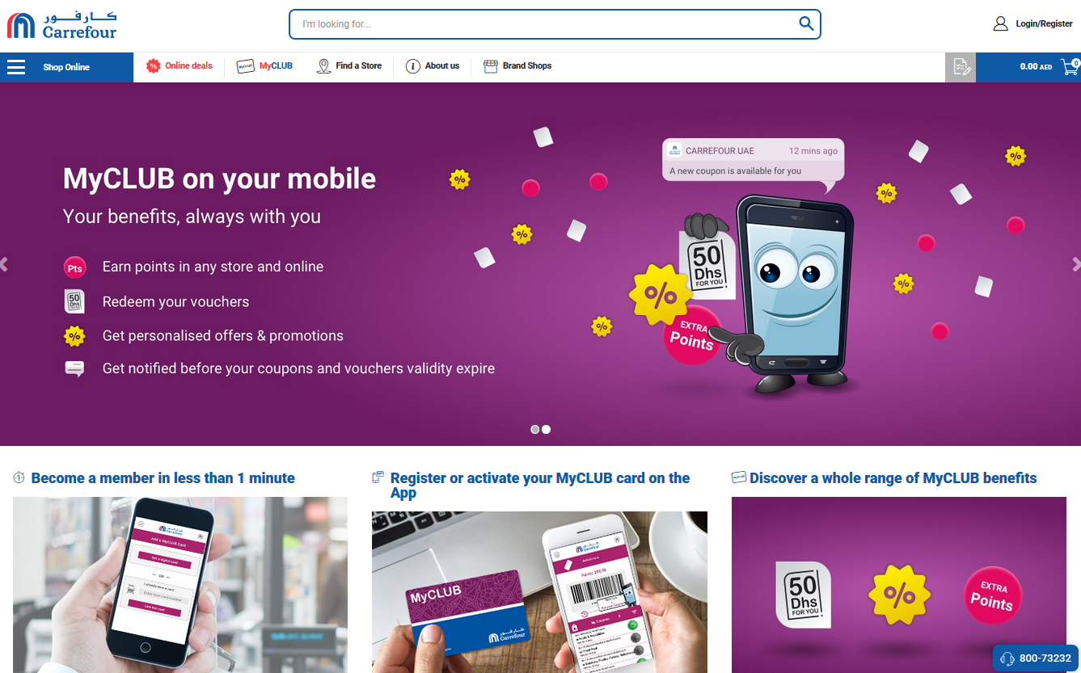
Carrefouruae.com
one of the largest hypermarket and supermarket chains in the world
created in 1995 by Majid Al Futtaim
serving 200 000 customers a day
Notes:
-38 countries across the Middle East, Africa, and Asia
-in 1995, Carrefour opened its first hypermarket in City Centre Deira UAE and through the years, expanded to over 175 Carrefour stores in 15 countries across the region, serving over 200,000 customers a day.
-offers an unrivalled choice of more than 100,000 food and non-food products as well as thousands of household goods.

Slide 33
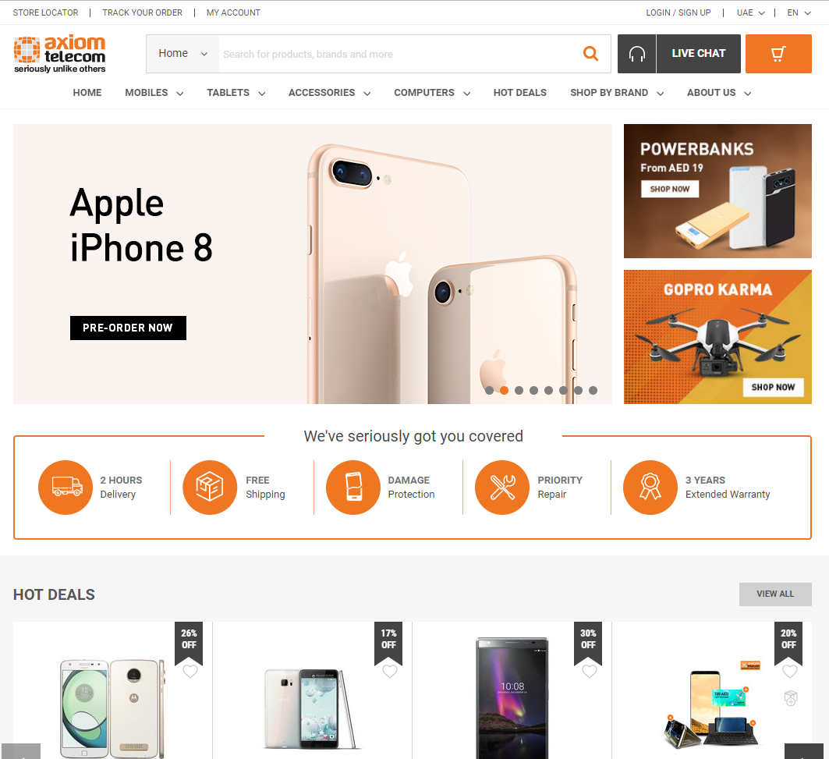
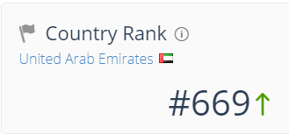
Axiom Telecom
Started in 1997 with 4 employees
Major distributor of mobile devices with the largest market share
Gulf region (GCC) in 2003
Axiom Sales & Numbers
2012: 2 billion USD
71% of the UAE mobile market (http://www.channelemea.com/spip.php?article7167 )
Lots of news is related to mobile technology
Notes:
Gulf cooperation council
71% share of the UAE mobile handset market

Slide 34
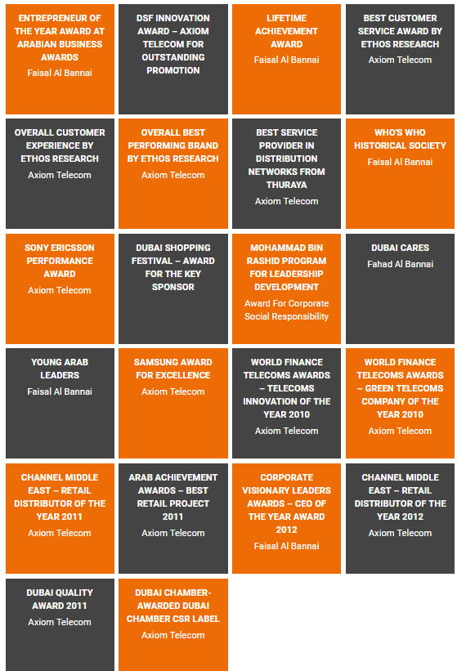
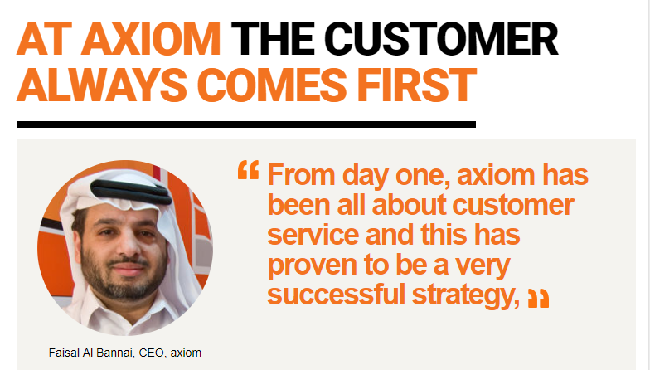
Fast growing company & Customer focused.
(Sources:
Nicholson, Chris V. (December 7, 2010). "Axiom Telecom Cancels I.P.O. - NYTimes.com". Dealbook.nytimes.com. Retrieved March 4, 2012.
a b Kerr, Simeon (September 22, 2010). "Axiom Telecom plans Dubai IPO". FT.com. Retrieved March 4, 2012.
Fitch, Asa (May 25, 2010). "Full: Axiom Telecom IPO to halve debts of Dh1bn - The National". Thenational.ae. Retrieved March 4, 2012.
"Dubai Holding sells stake in Axiom Telecom | Telecoms". AMEinfo.com. Archived from the original on August 30, 2011. Retrieved March 4, 2012.
Notes:
In December 2005, TECOM, a member of Dubai Holding, acquired a 40% share of the Axiom Telecom.

Slide 35
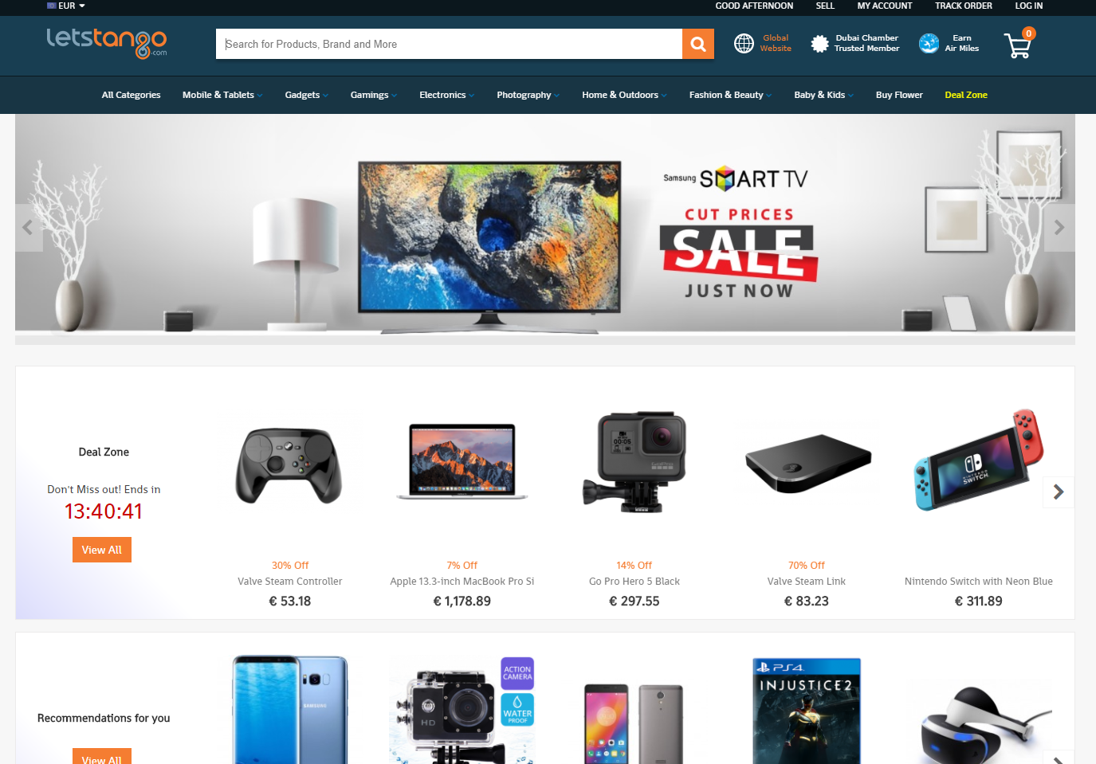
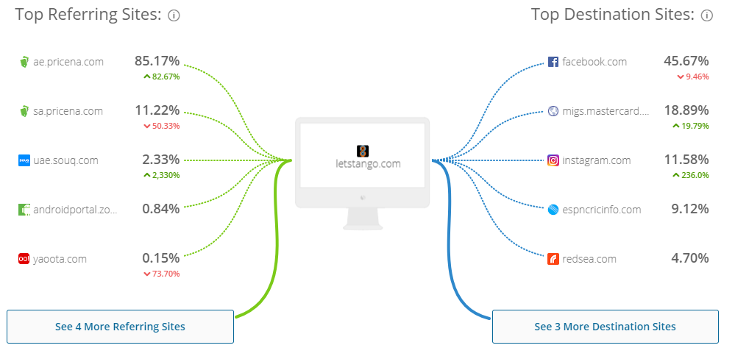
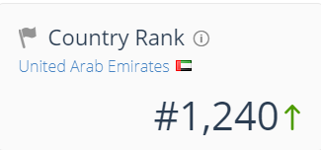
LetsTango
Company with a story
Considered the fastest growing online shopping store within UAE
$1.104 Monthly ad. Revenue
Notes:
Everyone knows that the tango relies on the grace and harmony of its dancers, that there must always be two involved, and that neither can soar without the other. That's why "it takes two to tango". And that's why LetsTango.com was created — to bring that essence of harmony and grace to online shopping, with the idea that we can be your partner in every step of the way, in giving you a revolutionary and fun shopping experience.
Founded in 2013 on June 26th

Slide 36
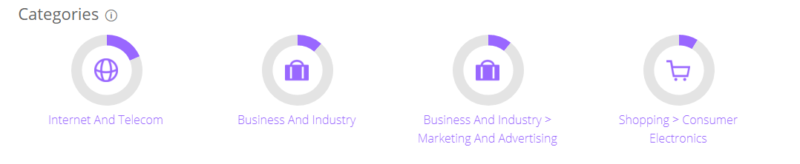
LetsTango
Sources:
https://www.similarweb.com/website/letstango.com#websiteContent
https://www.zawya.com/mena/en/company/LetsTangocom-12616302/
https://www.crunchbase.com/organization/letstango-com#/entity
https://startupflux.com/companies/letstango.com

Slide 37
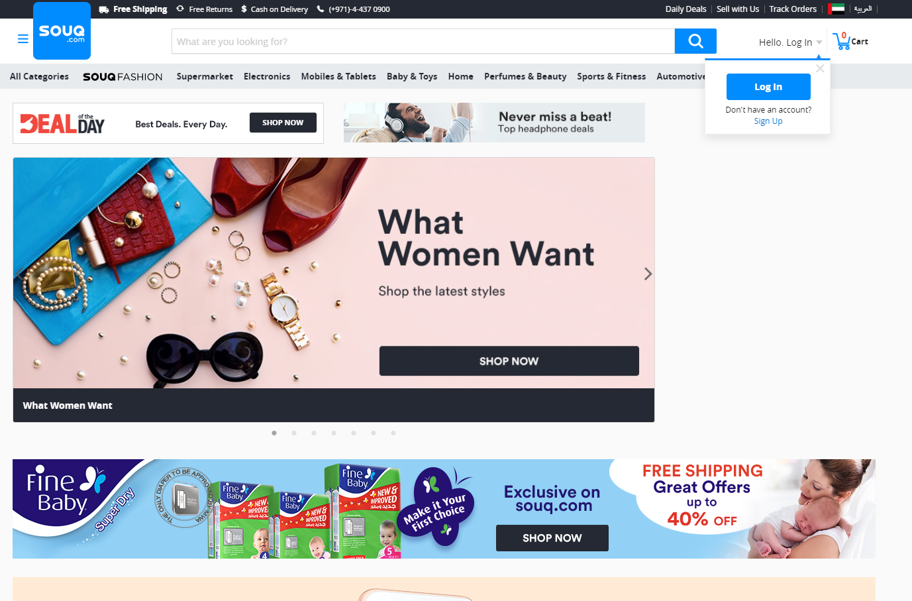
Souq
Largest E-commerce site in the Arab countries.
Founded in 2005 as an auction site
Changed model in 2011
March 2014: Naspers
October 2015: company value of 1 billion
March 2017: Emaar Malls offered 800 million
The amazon of the middle east, literally. (https://techcrunch.com/2017/03/28/amazon-confirms-acquisition-of-souq-marking-its-move-into-the-middle-east/ ) - Techcrunch
Notes:
In 2011 Souq.com changed its model to an online shopping site similar to Amazon.com with a marketplace and retail items for sale on its platform.
In March 2014, the company raised $75 million from Naspers, bringing the total Souq.com had raised since its inception to $150 million.
Backed by Tiger Global Management and Naspers in 2015.
In October 2015, it was reported that in a round of fundraising, the company was valued at around $1 billion, during that time, it had 10 million visitors monthly
On 27th of March Emaar Malls made an offer of 800 million for Souq. Also at that time it sold over 8.4 million products in 31 categories with around 45 million visitors per month!
The company was known as the amazon among the Arab countries, this became especially true when on the 28th of March, Amazon confirmed it would be taking over Souq later that year. The deal was supposed to be around ~700 million-ish.

Slide 38
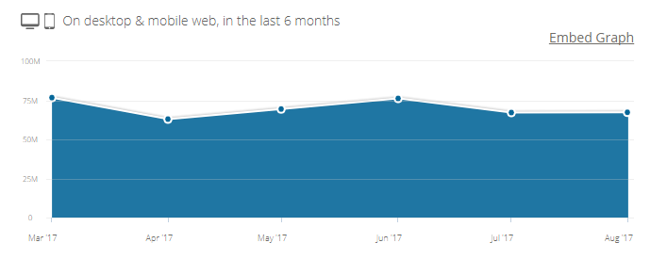
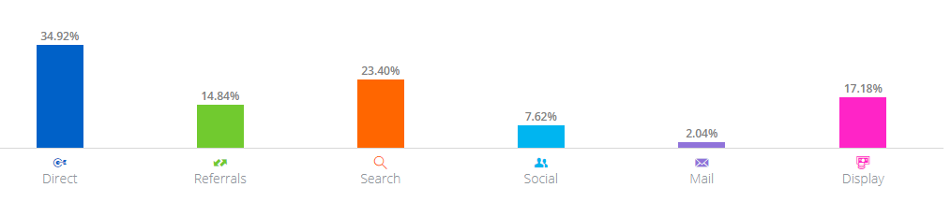
Source:
(https://www.similarweb.com/website/souq.com#overview )
Notes:
$344.784 ad revenue

Slide 39
Brazil
Rick | Davey | Stella

Slide 40
About Brazil
Total Population: 207,652,865
Average annual earning
Netherlands: 46,130 $ (usd)
Brazil: 8,840 $ (usd)
1 usd = 3,109 Brazilean reais
Big difference between rich and poor
Notes:
https://en.portal.santandertrade.com/analyse-markets/brazil/reaching-the-consumers
https://www.worlddata.info/average-income.ph
http://www.helpmijleven.org/brazilie/sloppenwijken.html

Slide 41
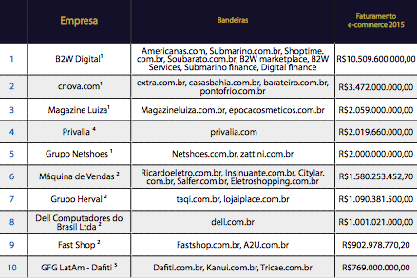
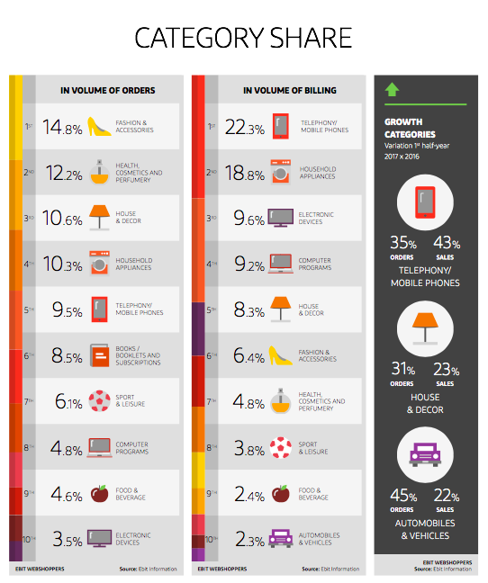
Top 10 e-commerce company's in Brazil
Notes:
http://sbvc.com.br/wp-content/uploads/2016/12/Ranking-SBVC-50-Maiores-Empresas-do-E-commerce-Brasileiro-2016.pdf
https://icthva-my.sharepoint.com/personal/heisenm001_hva_nl/_layouts/15/onedrive.aspx?csf=1&FolderCTID=0x012000C5AA97687DA6004DB7FD71892A522F99&id=%2Fpersonal%2Fheisenm001%5Fhva%5Fnl%2FDocuments%2FOnline%20Marketing%2FWebshoppers%5F36%2Epdf&parent=%2Fpersonal%2Fheisenm001%5Fhva%5Fnl%2FDocuments%2FOnline%20Marketing

Slide 42
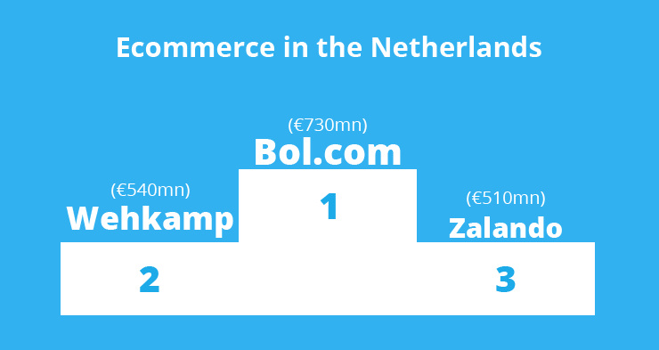
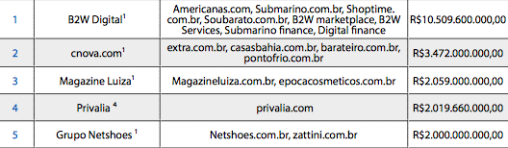
E-commerce companies compared (Brazil vs Netherlands)
Brazilië
Nederland
Notes:
http://sbvc.com.br/wp-content/uploads/2016/12/Ranking-SBVC-50-Maiores-Empresas-do-E-commerce-Brasileiro-2016.pdf
https://ecommercenews.eu/bol-com-biggest-online-retailer-netherlands/

Slide 43
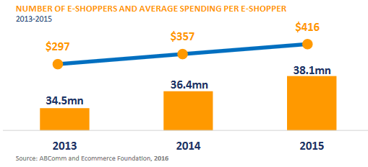
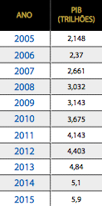
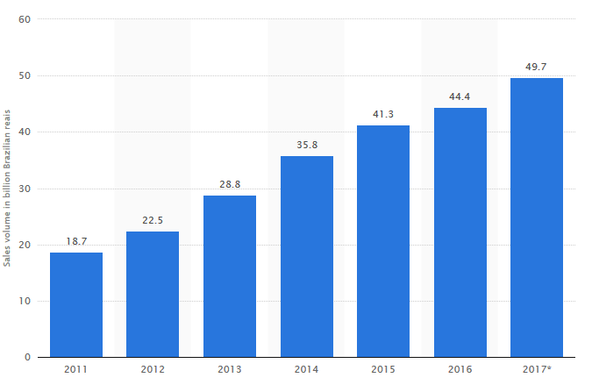
Profit & Turnover
E-commerce expenditure
Gros Domestic Product
E-commerce turnover
Notes:
http://sbvc.com.br/wp-content/uploads/2016/12/Ranking-SBVC-50-Maiores-Empresas-do-E-commerce-Brasileiro-2016.pdf
https://www.ecommercewiki.org/wikis/www.ecommercewiki.org/images/4/42/Brazil_B2C_E-commerce_Report.pdf
https://www.export.gov/article?id=Brazil-e-Commerce

